Slide 1
Notejam – Cloud Architecture
Prepared by
Lakshmi Prasanna Tumu

Slide 2
Table of Contents
Problem Statement
Proposed Architecture - AWS
Architecture – Key Components
Further Improvements
Costs
Benefits

Slide 3
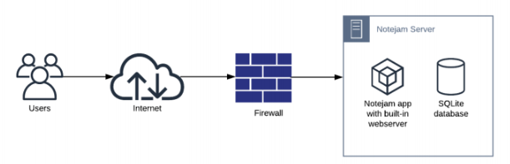
Problem Statement
Notejam is a web application which allows user to sign up/in/out and create/view/edit/delete notes. It is currently build as monolith containing built-in webserver and SQLite database.
The task at hand is to redesign the architecture so it can meet business requirements on chosen public cloud platform.

Slide 4
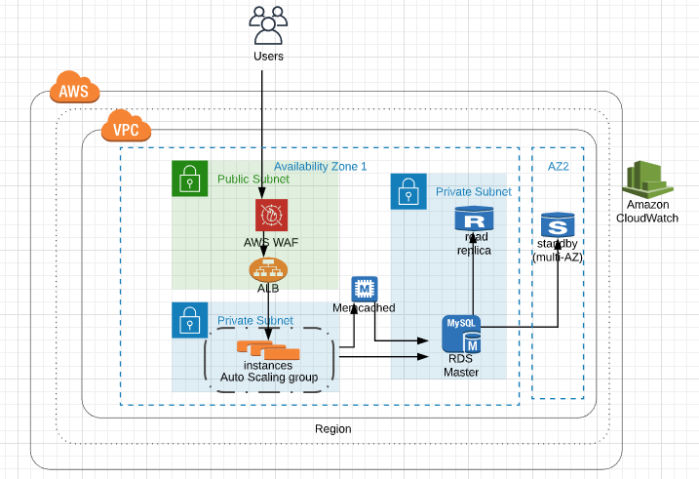
Proposed Architecture - AWS

Slide 5
Architecture – Key Components
Route53
Route53 in AWS is a managed domain name service. It is extremely reliable and cost effective way to route end users to Internet applications by translating names like www.example.com into the numeric IP addresses like 192.0.2.1
Elastic Load Balancer
The essence of the load balancer is to distribute load across the web servers hosting Notejam. It ensures performance, security & scalability.
Auto Scaling Group
An Auto scaling group (ASG) is a collection of servers that an application can use to handle its workload. With ASG scaling policy, no of servers handling traffic can be increased automatically when traffic is high and can be decreased when traffic is low.

Slide 6
Architecture – Key Components
Relational Database Service (RDS)
Amazon RDS is used to operate and scale a relational database in Cloud. When we provision a Multi-AZ DB Instance, Amazon RDS synchronously replicates the data to a standby instance in a different Availability Zone (AZ) for fault tolerance. We can also create a read replica to offload read traffic from primary database instance.
CloudWatch
CloudWatch is used to monitor application, respond to system-wide performance changes. It also provides logs, monitors and events to give a unified view of AWS resources, applications, and services that run on AWS
ElastiCache
Amazon ElastiCache works as an in-memory data store and cache to support the most demanding applications requiring sub-millisecond response times.

Slide 7
Further Improvements
Further Improvements can be done by including below resources
CloudFormation
NAT Gateway
Bastion Host
Web application Firewall
CloudFront
S3
SNS Notifications
SES Notifications

Slide 8
Costs
S.No | Resource | Cost Per Month in USD
1 | Route53 | $2
2 | Load Balancer | $25
3 | Auto Scaling group | $200
4 | Amazon RDS | $350
5 | ElastiCache | $45
6 | WAF Firewall | $200
7 | CloudWatch (Metrics and Alarms) | $30
Total estimated cost for one region cluster per month ~ $850

Slide 9
Benefits
Scalability
High Availability
Fault Tolerance
Security
Disaster recovery
Modularity

